Slide 1

Shree Ramswaroop Memorial University
JavaScript Lab Assignment 4
Submitted to : Kshitiz Srivastav
Submitted By : Mukesh Prajapati
Branch : B . tech (cs industry integrated)
Roll-No : 202410101230007

Slide 2
Weather App

Slide 3
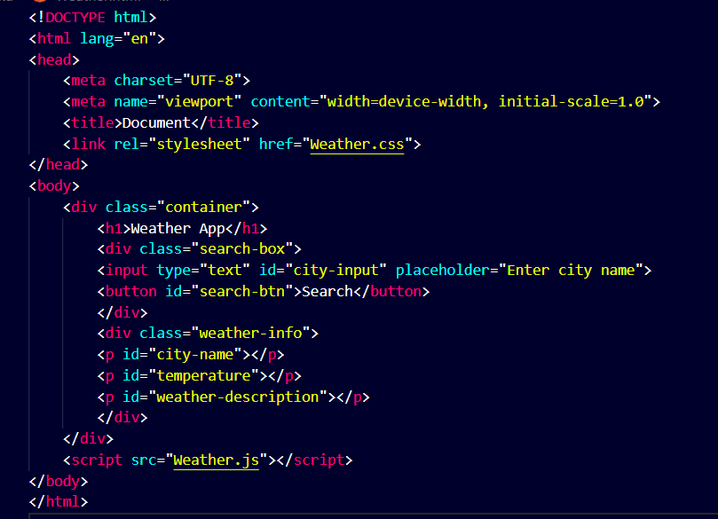
EXPERIMENT:--4
Create an Input Field For Users to Enter City Name:-
HTML Code:--

Slide 4
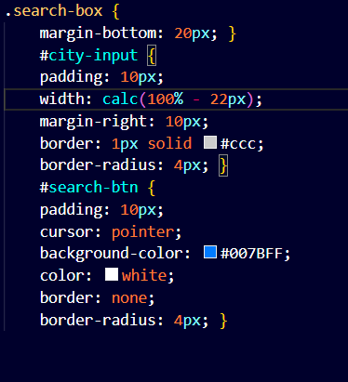
CSS code:--

Slide 5
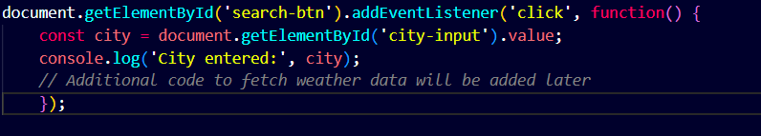
JavaScript Code:--

Slide 6
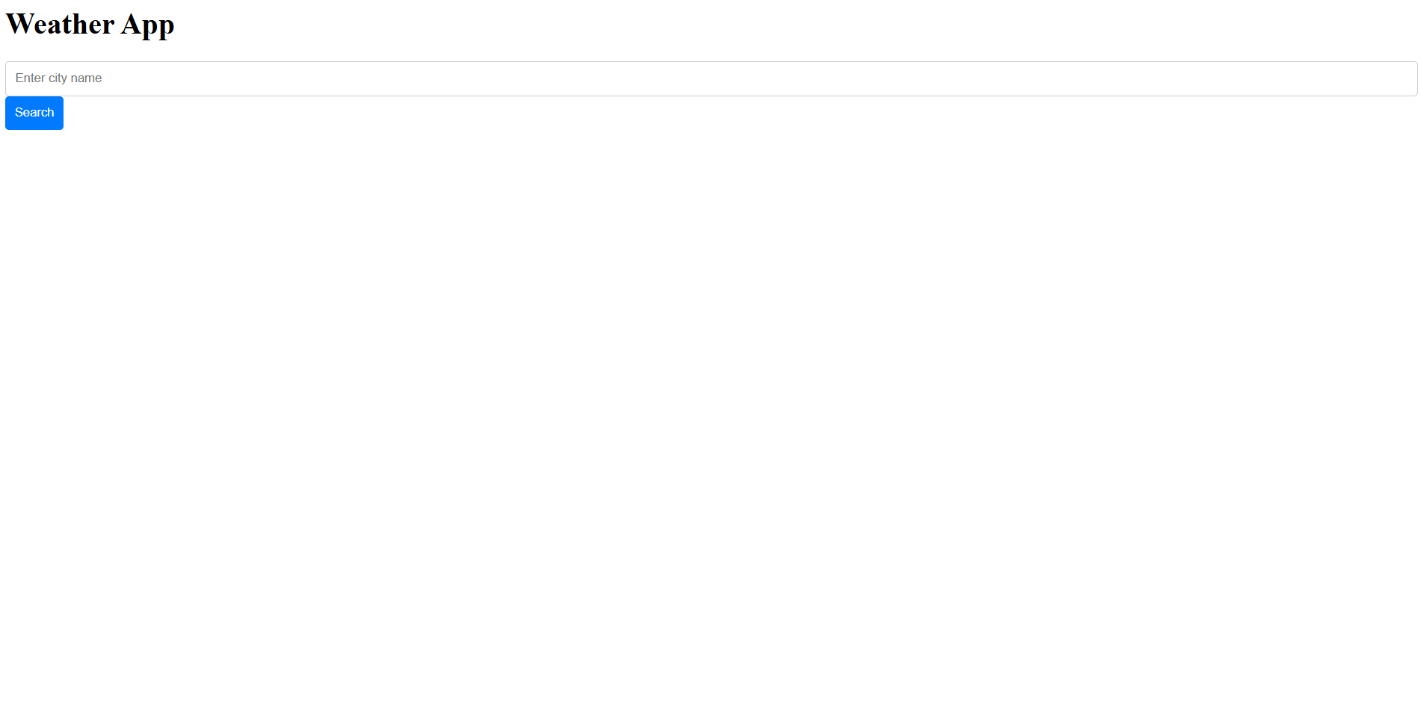
Based on the above HTML, CSS and JAVASCRIPT THEN OUTPUT OF THE CODE (RESULTS):--

Slide 7
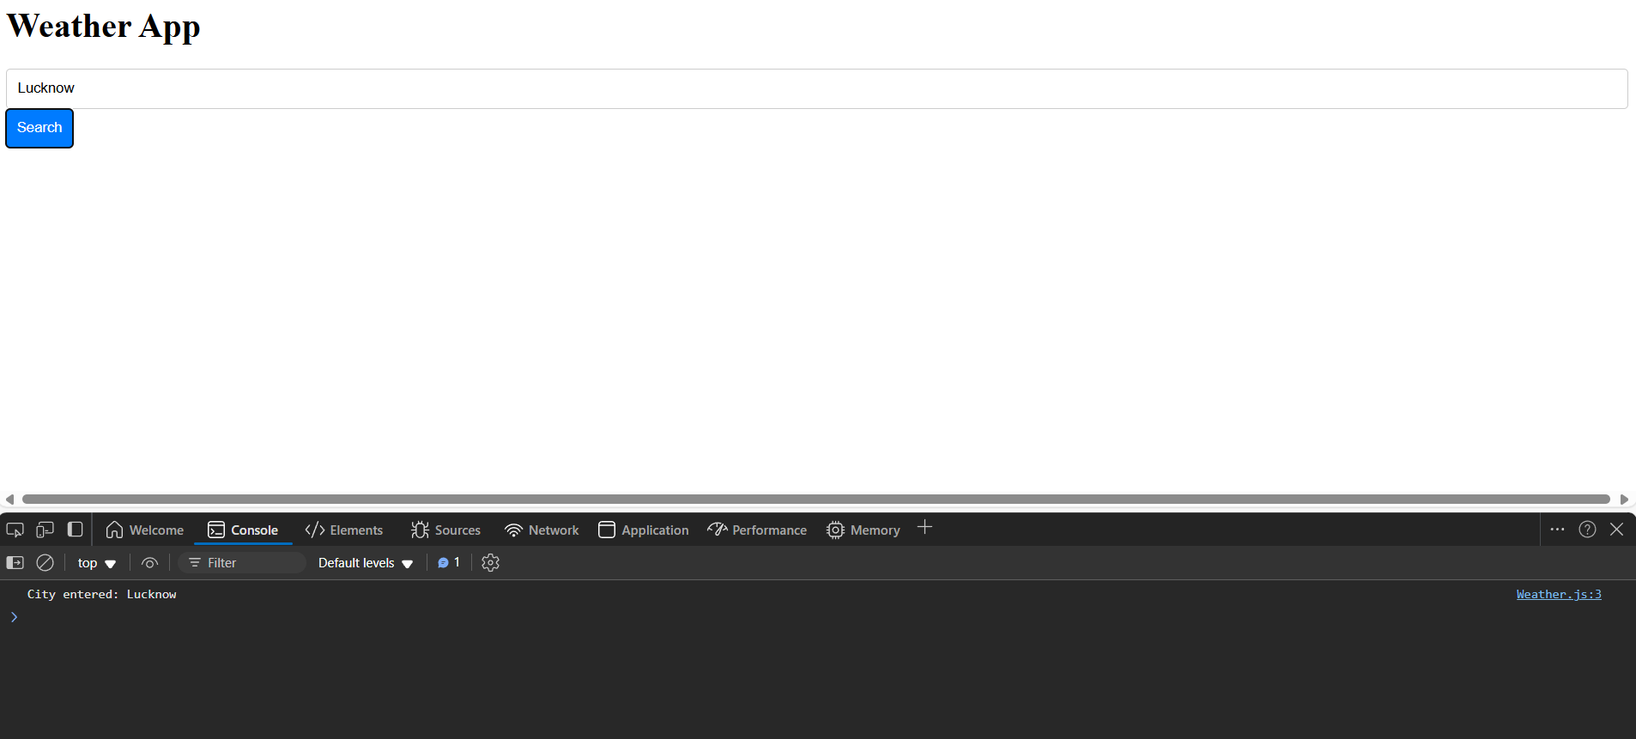
RESULTS ON CONSOLE WINDOW

